Slide 1
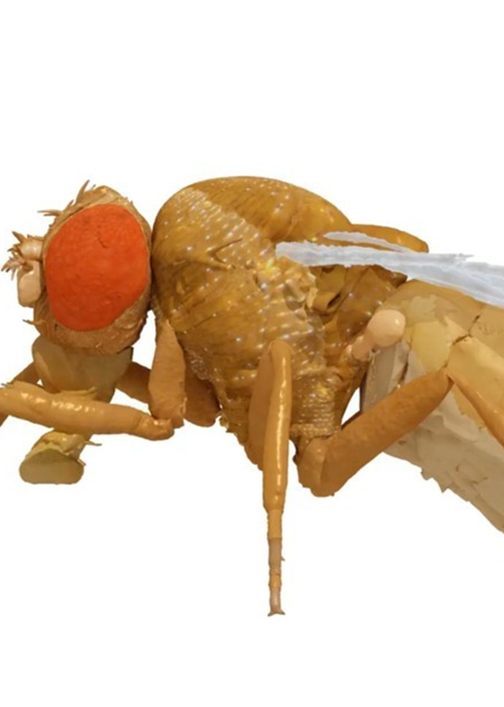
NAVIGATION AND PATHFINDING
Jean Cordonnier
Flore Munier-Jolain
31/10/2023

Slide 2
Contents
Task definition
Random Walk
Path integration
Turning
Follow a heading
Reinforcement learning
Critics
Next steps

Slide 3
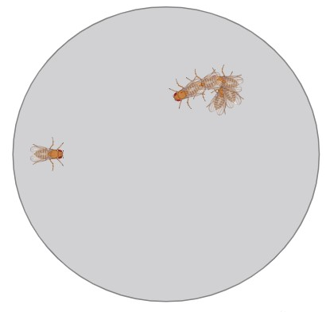
Task definition
Maintain spatial awareness
Remember the location of a food site
Go back to its starting point
1 Random Walk
▶ Efficient walk
▶ Stop criteria
[Behbahani et al, 2021]
2 Integration of return heading
▶ Precise return vector
▶ Biologically relevant
▶ RL friendly
3 Heading follow
▶ Turning challenge
▶ Smooth follow
▶ Stop criteria

Slide 4

Random walk
nmf = HybridTurningNMF → nmf.step(action)
[δ_{L} , δ_{R}] modulate amplitude and direction of the CPGs
[0.2 , 1.2] [1.2 , 0.2]
counting step variable
3 normal distributions
Rules definition

Slide 5
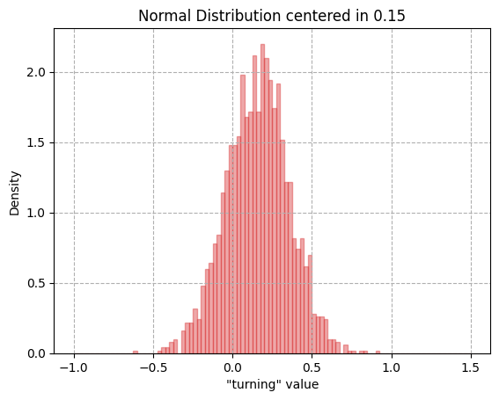

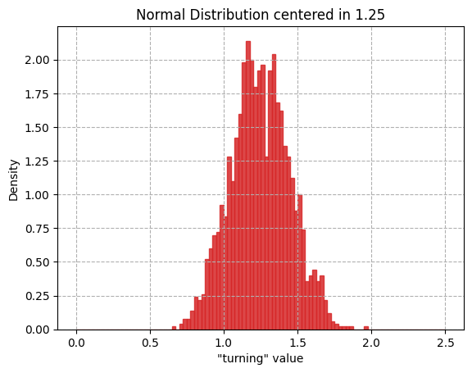
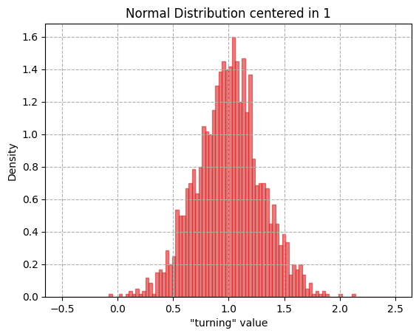
Random walk
N(1.25, 0.3) p = 0.25
δ_{L}
N(1.0, 0.3) p = 0.5
[ δ_{L} - δ_{R} ]
N(0.15, 0.2) p = 0.25
For counting_step iterations
Random choice
counting_step
Random choice
N(1.25, 0.3) p (δ_{L})
Γ(140, 65) ↑counting_step
[1.2 , 1.2] next
δ_{R}
N(1.0, 0.3) p (δ_{L})
True
Γ(50, 30) ↓counting_step
[ δ_{L}, δ_{R}] next
N(0.15, 0,2) p (δ_{L})
False
δ_{L} >1.2 δ_{R} ↑ N(0.15, 0.2) prob.
| δ_{L} - δ_{R} |
δ_{L} <0.4 δ_{R} ↑ N(1.25, 0.3) prob.
> 0.65 Turn = True
< 0.65 Turn = False

Slide 6
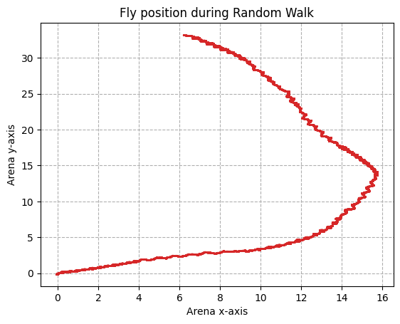
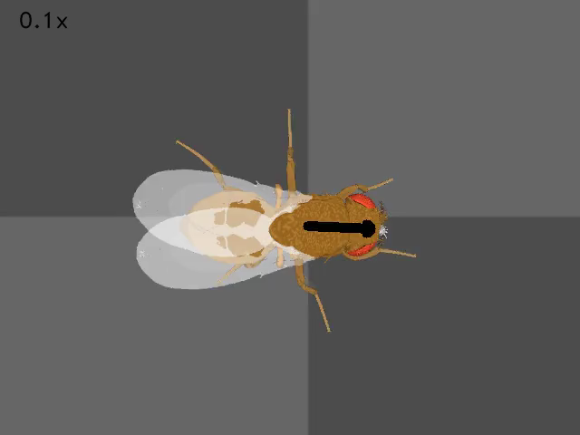
Random walk results
↳
Statistical analysis on multiple trials

Slide 7
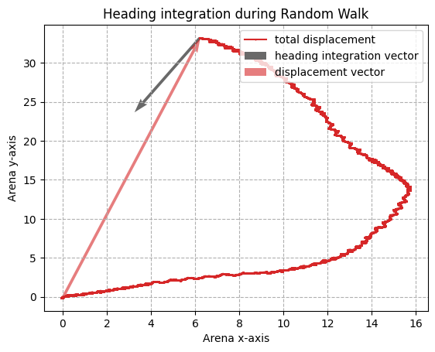
Path integration - headings
Sum normalized headings (x,y) from the simulation
Scaling headings with speed from the simulation
⚠ Non collinearity problem

Slide 8
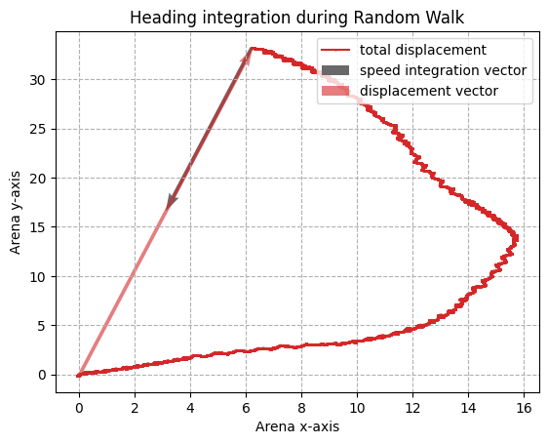
Path integration - speeds
Sum only velocity (x,y) from the simulation
✔ Perfect collinearity

Slide 9
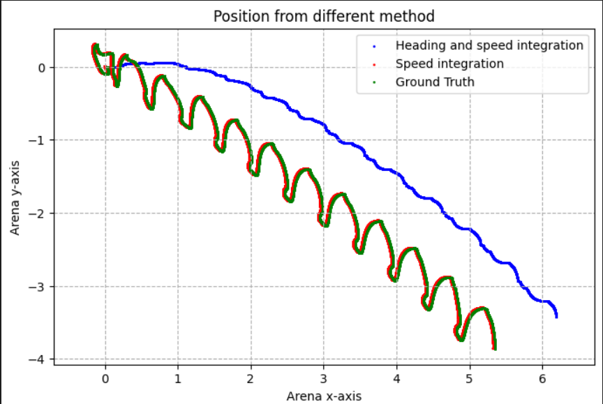
Path integration - Heading vs Speed
Overview of the position integration using different methods
We can see that the fly drifts
⚠ Heading orientation ≠ Speed orientation

Slide 10
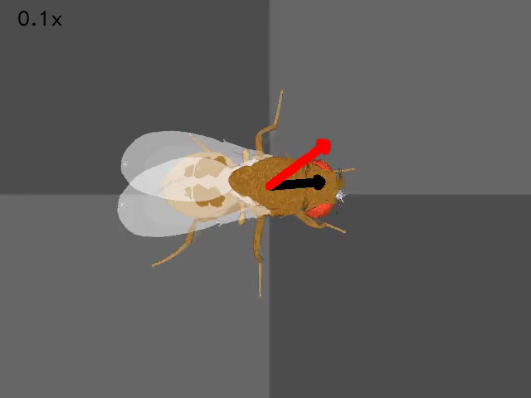

Slide 11
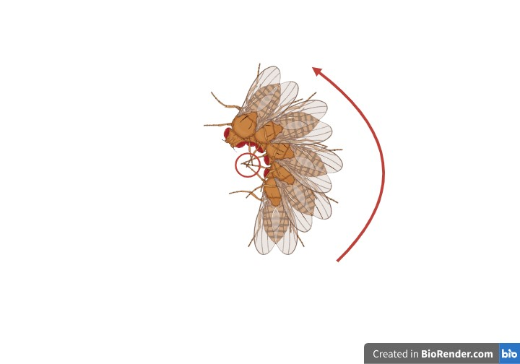
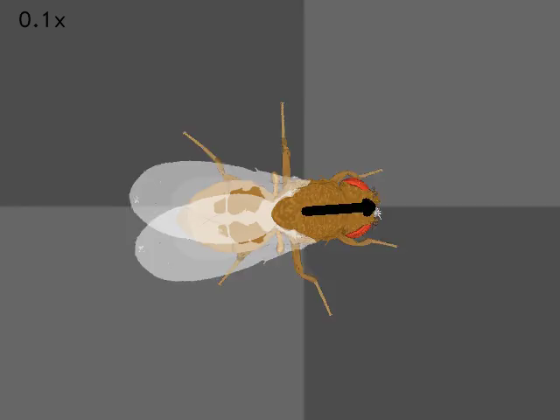
Turning - Problem
At the end of the Random Walk the fly has to turn around
Large amplitude
Small amplitude
⚠ Blocked front leg retraction

Slide 12
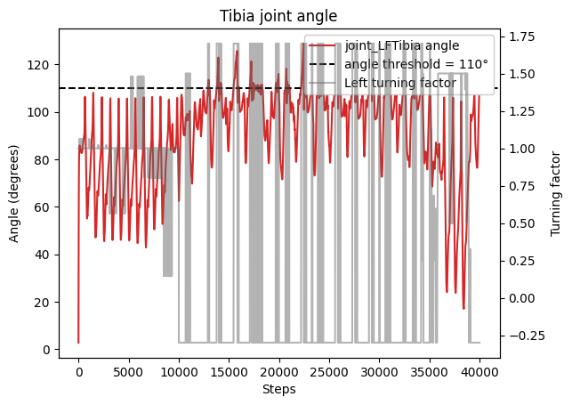
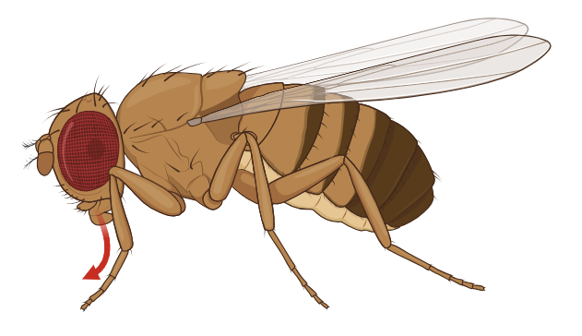
Turning - Solution
Tibia joint angle
Joint angle > 110°→ Leg step
Leg step → δ_{int} = 1.70
Leg step → δ_{ext} = 0.50
Turning

Slide 13
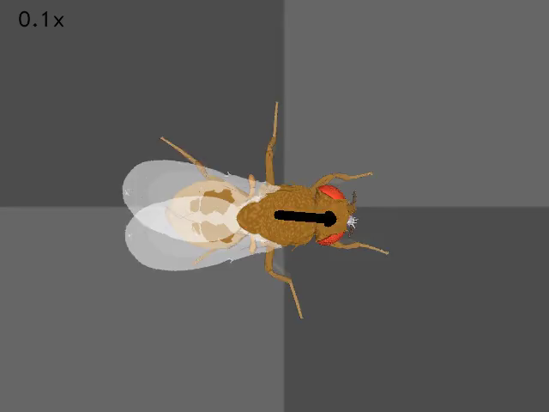
Turning - Solution
✔ Fly can turn
↳Test with contact force ⦰ adhesion force

Slide 14
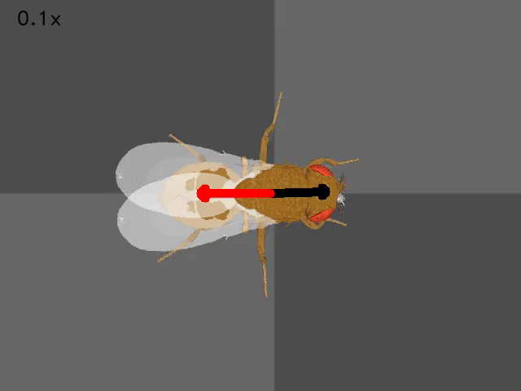
Heading following
Goal: make the fly follow a selected heading using a PID controller
Very hard to tune with stability problems but works well for small heading change
We computed the error from a goal heading and put it into a simple PID controller

Slide 15
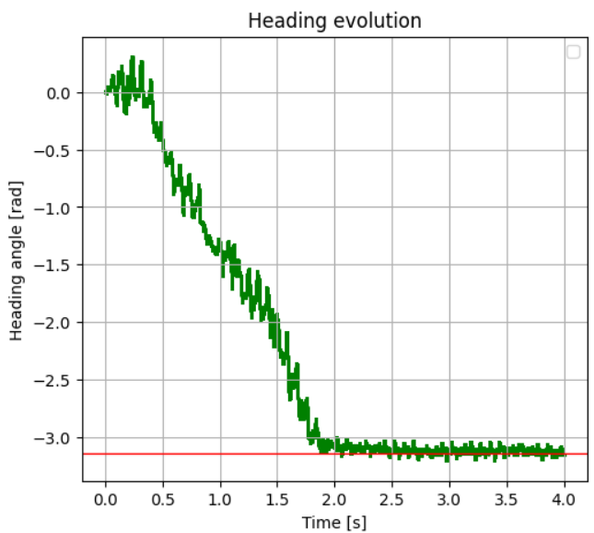
Heading following
PID controller: results
No overshoot
The fly manages to reach the heading objective smoothly
Slow start
%% ADD graphs of heading

Slide 16
Reinforcement learning
To explore new ways of determining the heading: with idiothetic or allothetic cues → LSTM
To explore new ways of controlling the fly → Hybrid CPG-RL controller optimized for turning
To make the fly make optimal decision based on her environment
We think that using a RL-based approach to solve this problem would be efficient due to the high dimensionality and high degree of complexity of the simulation

Slide 17
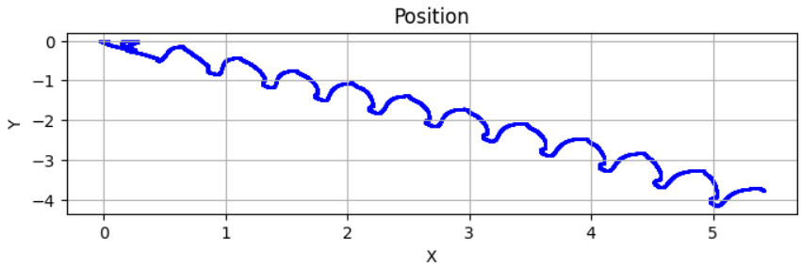
Critics
Path integration relies on simulation parameters → non biologically relevant
Non natural, jerky turning behavior
Difficulties to make tight turn → need for a new turning controller more suitable for our application

Slide 18
Next steps
Develop RL algorithm → simulation independent behavior
Improve controller allowing the fly to smoothly follow a specific heading
Arbitrary distance → concrete targets (food …)
Complicate the environment
Add multiple targets
Add repellent odors
And the ambitious ultimate step …
Create a biologically relevant Neural network for this task

Slide 19
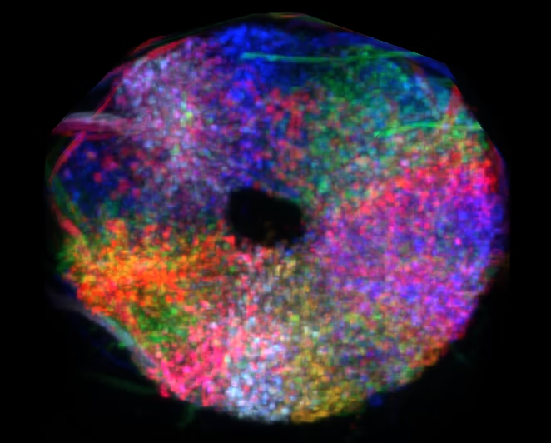
Thanks for your attention
?

Slide 20
Summary
Random walk
Position integration
With heading
With speed
Turning: stepping problem
Heading following using PID
Integration of RL

